Slide 1
MICRO CREDIT DEFAULTER MODEL
Submitted by:
Reena

Slide 2
AGENDA
Overview.
Problem Statement.
What is Micro Credit?
Importance of Micro Credit Defaulter Model.
Exploratory data analysis.
Visualizations.
Analysis.
Data cleaning steps.
Data Balancing.
Model Building.
ROC-AUC Curve.
Saving the model and predictions from saved best model.
Conclusion.

Slide 3
OVERVIEW
In this particular presentation we will be looking on:
•How to analyze the dataset of Micro Credit Defaulters.
•What are the EDA steps in cleaning the dataset.
•Overall analysis on the problem.
•Model building from the cleaned dataset.
•Predicting defaulters for saved model.

Slide 4
PROBLEM STATEMENT
A Microfinance Institution (MFI) is an organization that offers financial services to low income populations. Many microfinance institutions (MFI), experts and donors are supporting the idea of using mobile financial services (MFS) which they feel are more convenient and efficient, and cost saving, than the traditional high-touch model used since long for the purpose of delivering microfinance services. Though, the MFI industry is primarily focusing on low income families and are very useful in such areas, the implementation of MFS has been uneven with both significant challenges and successes. Today, microfinance is widely accepted as a poverty-reduction tool, representing $70 billion in outstanding loans and a global outreach of 200 million clients. We are working with one such client that is in Telecom Industry. They have launched various products and have developed its business and organization based on the budget operator model, offering better products at Lower Prices to all value conscious customers through a strategy of disruptive innovation that focuses on the subscriber.

Slide 5
WHAT IS MICRO CREDIT?
Microcredit is an extremely small loan given to those who lack a steady source of income, collateral
It is used as a way to obtain a loan, acting as a protection against potential loss for the lender should the borrower default in his payments., or any credit history.

Slide 6
IMPORTANCE OF MICRO CREDIT DEFAULTERS MODEL
Microfinance in India has seen incredible growth in the last two decades in terms of the number of Microfinance customers and institutions offering Microfinance. The model will be a good way for the management to understand whether the customer will be paying back the loaned amount within 5 days of insurance of loan. The relationship between predicting defaulter and the economy is an important motivating factor for predicting micro credit defaulter model

Slide 7
EXPLORATORY DATA ANALYSIS
Imported necessary Libraries and loaded the dataset.
Statistical Analysis done like Shape, info, nunique, value_counts.
Dropped columns with more than 90% of Zero values.
Dropped columns withall unique or 1 unique value.
Feature extraction done in pdate and extracted pday, pmonth and pyear.

Slide 8
Converted few columns with negative values to positive values.
Checked Correlation between Variables and Feature
Outliers removed, Encoded categorical columns.
Skewness removed, removed columns with Multicollinearity issue.
Using Min-Max Scaler, normalized the data.
No Null values in the dataset.

Slide 9
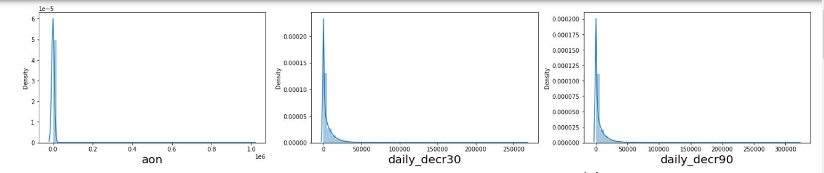
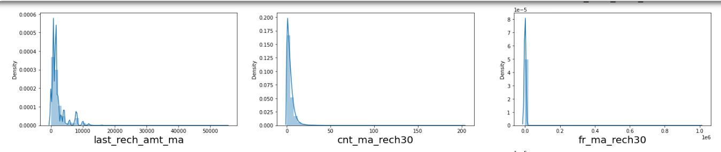
VISUALIZATION

Slide 10
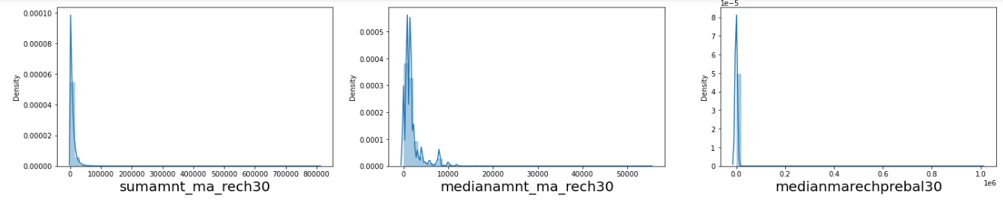
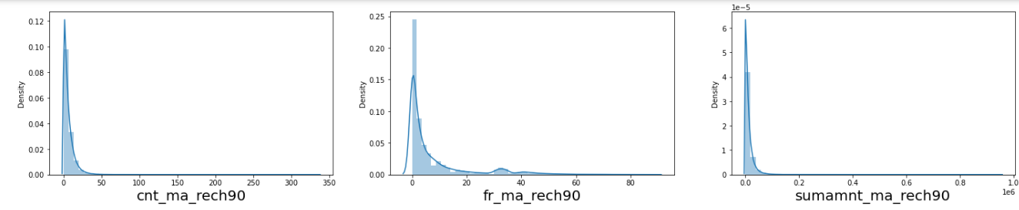
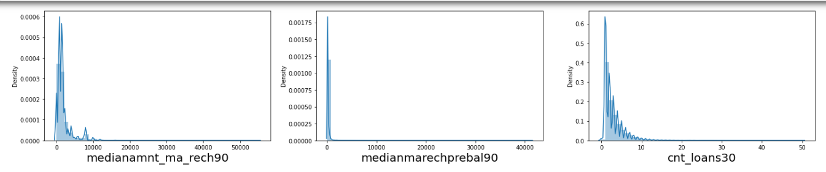

Slide 11
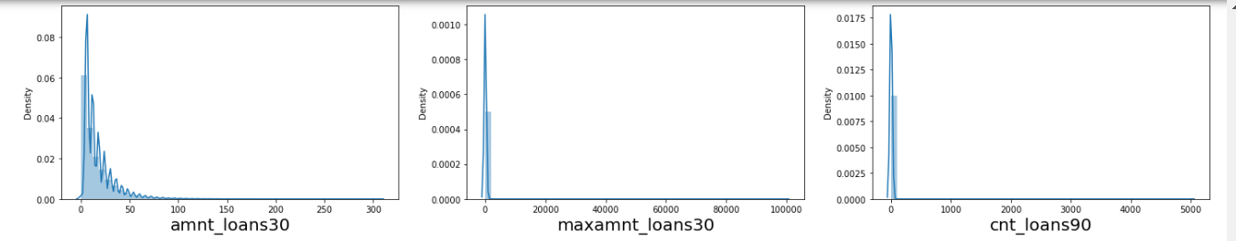
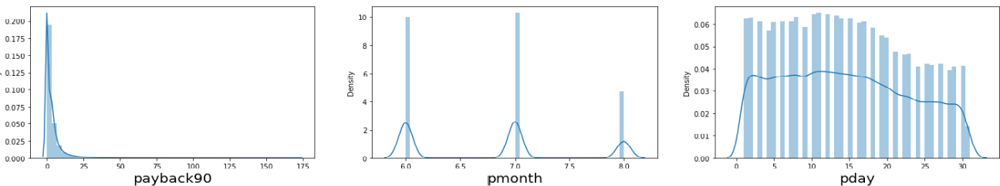

Slide 12
OBSERVATIONS:
Almost all columns are right skewed.
We have symmetrical distribution for the pday and pmonth columns.
Count plot of Target column

Slide 13
ANALYSIS
I have used dist plot for each univariate numerical features and it says that there is skewness in almost all columns.
I have used Bar-plots to find the relationship between columns and Target.
I found that in maximum features the count of non-defaulters is high compared to defaulters so the risk is less comparatively.

Slide 14
DATA CLEANING STEPS
In my datasets I did not found null values, but I found outliers and skewness.
To remove outliers I have used percentile method. And to remove skewness I have used yeo-johnson method.
To replace the negative values to positive values I have used abs.
Use of Pearson’s correlation coefficient to check the correlation between dependent and independent features.
Also I have used Normalization. Then followed by model building with all Classification algorithms.

Slide 15
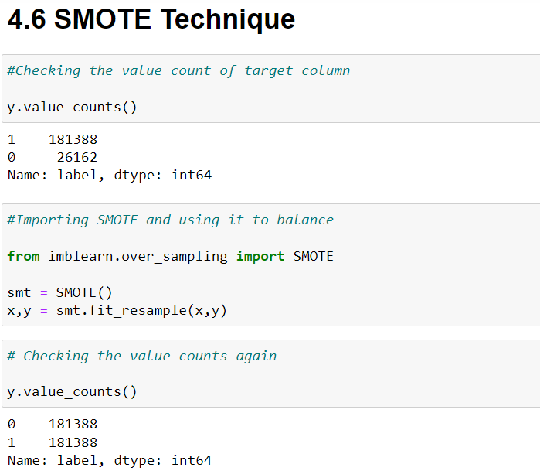
DATA BALANCING

Slide 16
MODEL BUILDING
Since label was my target and it was a classification column with 0-defaulter and 1-Non-defaulter, so this particular problem was Classification problem. And I have used all Classification algorithms to build my model. By looking into the difference of accuracy score and cross validation score I found RandomForestClassifier as a best model with least difference. Also to get the best model we have to run through multiple models and to avoid the confusion of overfitting we have go through cross validation. Below are the list of classification algorithms I have used in my project.
Decision Tree Model
Random Forest Classifier
KNN Classifier
XGB Classifier

Slide 17
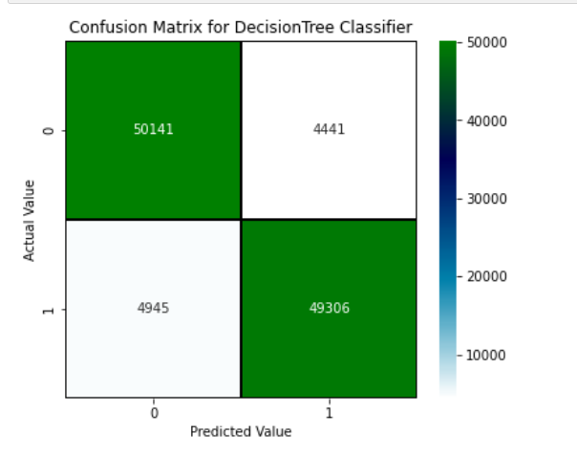
DECISION TREE CLASSIFIER MODEL

Slide 18
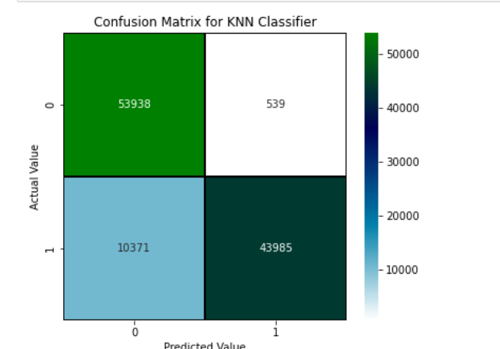
KNN CLASSIFIER MODEL

Slide 19
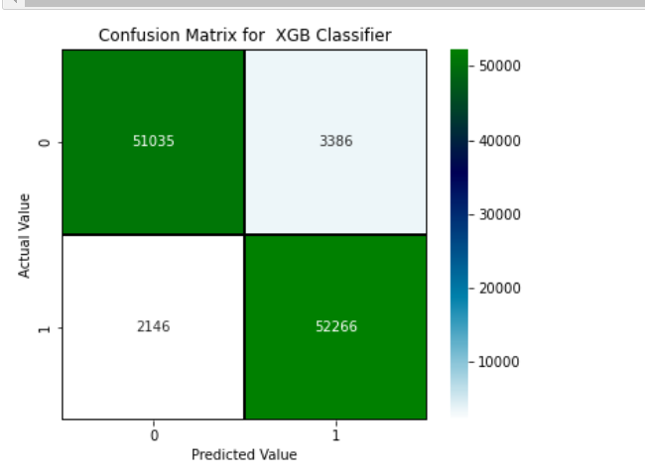
XGB CLASSIFIER MODEL

Slide 20
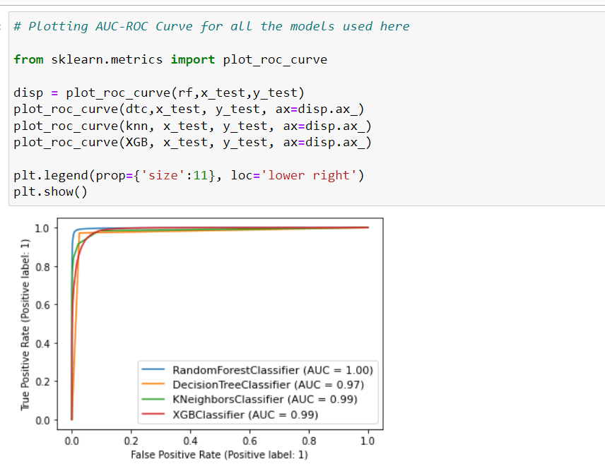
AUC-ROC CURVE

Slide 21
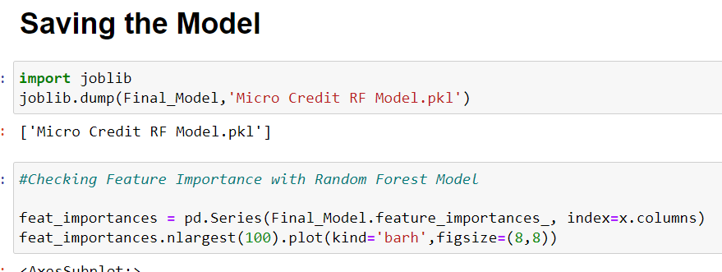
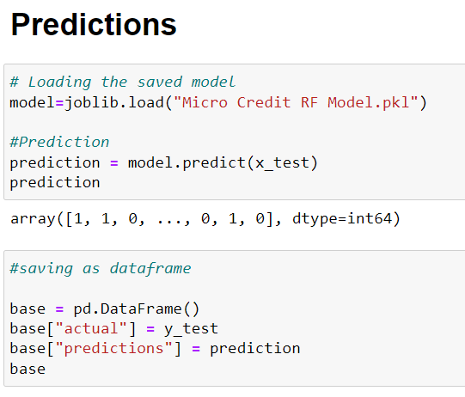
SAVING THE MODEL AND PREDICTIONS

Slide 22
THANK YOU

